Slide 1
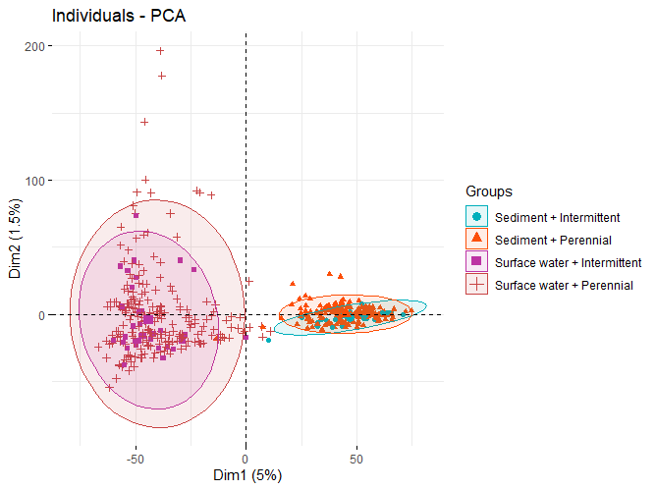
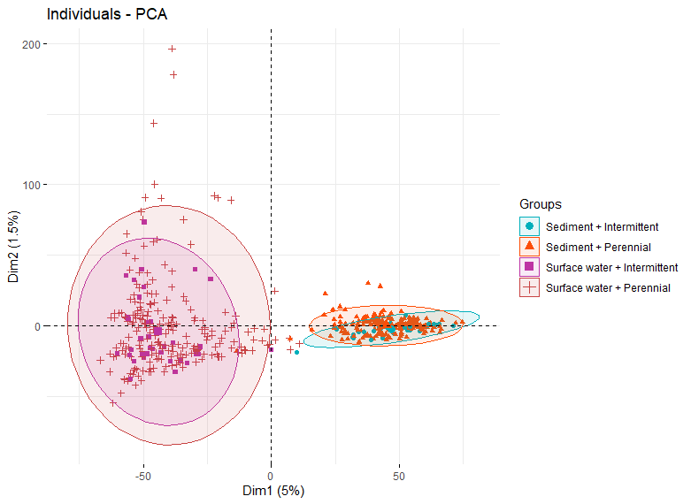
pH = 7
Lambda
delGcox
“S19S_0079_Sed_Field_ICR_D_p2” was an outlier, excluded in this figure

Slide 2

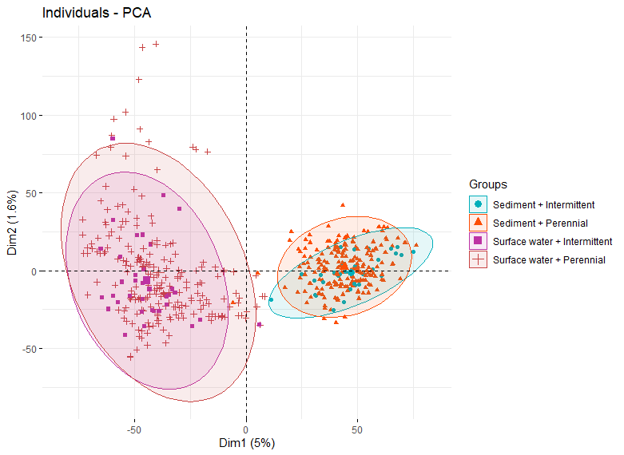
Sample-specific pH
Lambda
delGcox

Slide 3
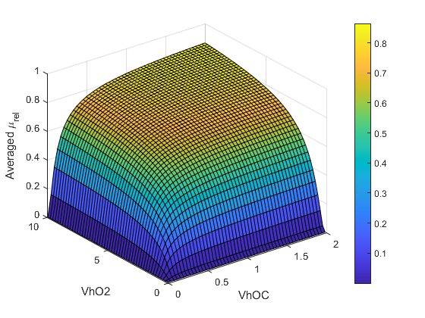
 | Low limitation | High limitation
VhOC | 2 | 0.05
VhO2 | 10 | 0.5

Slide 4
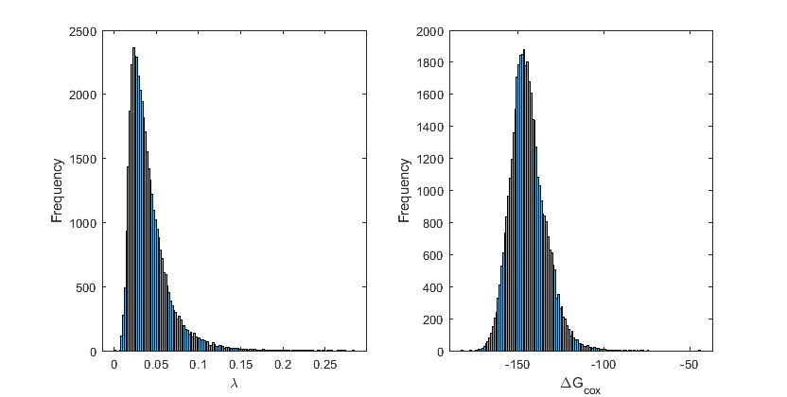

Slide 5
